Slide 1
SOAP Based Web Services
Dr David Wyatt

Slide 2
Session Plan
Monolithic Vs SOA Vs Microservices
Service-Oriented Architecture (SOA)
  Why SOA?
  SOA Architectural Principles
Web Services
  Web Service Characteristics
  Web Service Roles
  Web Service Protocol Stack
  UDDI
SOAP
  Simple Object Access Protocol (SOAP)
  SOAP Service Architecture
  Overview of SOAP
  SOAP Message (Building blocks)
  Example SOAP Web Services
Web Services Description Language (WSDL)

Slide 3
Monolithic Vs SOA Vs Microservices
Monolithic
SOA
Microservices

Slide 4
Service-Oriented Architecture (SOA)
Service Oriented Architecture
A paradigm for organizing and utilizing distributed capabilities that may be under the control of different ownership domains.
solve a large problem can be better constructed, carried out, and managed if it is decomposed into a collection of smaller, related pieces
“A set of components which can be invoked, and whose interface descriptions can be published and discovered” - World Wide Web Consortium (W3C)
Notes:
Because the term "service-oriented" has existed for some time, it has been used in different contexts and for different purposes. One constant through its existence has been that it represents a distinct approach for separating concerns. What this means is that logic required to solve a large problem can be better constructed, carried out, and managed if it is decomposed into a collection of smaller, related pieces. Each of these pieces addresses a concern or a specific part of the problem.
This approach transcends technology and automation solutions. It is an established and generic theory that can be used to address a variety of problems. What distinguishes the service-oriented approach to separating concerns is the manner in which it achieves separation.”

Slide 5
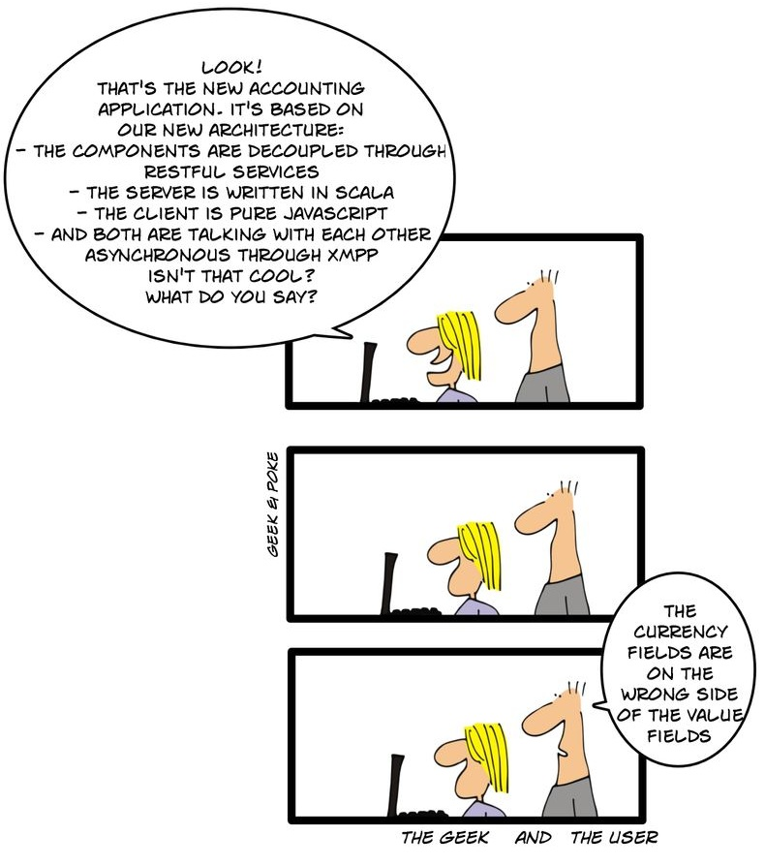
Why SOA
Promotes architectural composability
Fosters inherent reusability
Emphasizes extensibility
Supports a service-oriented business modelling paradigm
Implements layers of abstraction
Promotes loose coupling throughout the enterprise
Promotes organizational agility

Slide 6
SOA Architectural Principles
Loose coupling
  Services maintain a relationship that minimizes dependencies and only maintains an awareness of each other
Service contract
  Services adhere to a communications agreement as defined collectively by one or more service description documents
Service abstraction
  Beyond what is described in the service contract, services hide logic from the outside world
Service reusability
  Logic is divided into services with the intention of promoting reuse

Slide 7
SOA Architectural Principles
Service composability
  Collections of services can be coordinated and assembled to form composite services
Service autonomy
  Services have control over the logic they encapsulate
Service optimization
  All else equal, high-quality services are generally considered preferable to low-quality ones
Service discoverability
  Services are designed to be outwardly descriptive so that they can be found and assessed via available discovery mechanisms

Slide 8
Simple Object Access Protocol (SOAP)
SOAP
  XML-based protocol for accessing web services
    may run over HTTP
    but that's just one option (SOAP over Pigeon!)
  Protocol for exchanging information between computers
  Light Weight
    based on the XML language, which itself is a lightweight data interchange language
  Platform and Language independent
    can work with any programming language but there can be some challenges
  Simple and extensible
Notes:
When developing Web services, you need to have some of language which can be used for web services to talk with client applications. SOAP is the perfect medium which was developed in order to achieve this purpose. This protocol is also recommended by the W3C consortium which is the governing body for all web standards.
SOAP is a light-weight protocol that is used for data interchange between applications. Note the keyword 'light.' Since SOAP is based on the XML language, which itself is a light weight data interchange language, hence SOAP as a protocol that also falls in the same category.
SOAP is designed to be platform independent and is also designed to be operating system independent. So the SOAP protocol can work any programming language based applications on both Windows and Linux platform.

Slide 9
SOAP Service Architecture
PACKAGED APPLICATION
& LEGACY SYSTEMS
Interfaces in implementation independent format
XML-based data is easily exchanged
Designed for remote access, across heterogeneous platforms
J2EE™ APPLICATION
.NET™
APPLICATION
XML
SOAP
HTTP
WEB SERVICES
INTERFACE
PARTNER SYSTEM
FUTURE
SERVICES

Slide 10
Web Services
Web Service
  standardized medium to propagate communication between the client and server applications on the World Wide Web and designed to perform a certain set of tasks
  Is available over the Internet or private (intranet) networks
  Uses a standardized XML messaging system
  Is not tied to any one operating system or programming language
  Is self-describing via a common grammar
  Is discoverable via a simple find mechanism
Notes:
A web service is any piece of software that makes itself available over the internet and uses a standardized XML messaging system. XML is used to encode all communications to a web service. For example, a client invokes a web service by sending an XML message, then waits for a corresponding XML response. As all communication is in XML, web services are not tied to any one operating system or programming language—Java can talk with Perl; Windows applications can talk with Unix applications.

Slide 11
Web Services
Self-Contained
  modular, distributed, dynamic applications that can be described, published, located, or invoked over the network
Message Exchange
  collection of open protocols and standards used for exchanging data between applications or systems
Searched
  The web services can be searched for over the network and can also be invoked accordingly
Functionality
  When invoked the web service would be able to provide the functionality to the client which invokes that web service
Notes:
Web services are self-contained, modular, distributed, dynamic applications that can be described, published, located, or invoked over the network to create products, processes, and supply chains. These applications can be local, distributed, or web-based. Web services are built on top of open standards such as TCP/IP, HTTP, Java, HTML, and XML.
Web services are XML-based information exchange systems that use the Internet for direct application-to-application interaction. These systems can include programs, objects, messages, or documents
A web service is a collection of open protocols and standards used for exchanging data between applications or systems. Software applications written in various programming languages and running on various platforms can use web services to exchange data over computer networks like the Internet in a manner similar to inter-process communication on a single computer. This interoperability (e.g., between Java and Python, or Windows and Linux applications) is due to the use of open standards.

Slide 12
Web Service Characteristics
XML-Based
  Web Services uses XML to represent the data at the representation and data transportation layers
Loosely Coupled
  client and the web service are not bound to each other, which means that even if the web service changes over time, it should not change the way the client calls the web service
Synchronous or Asynchronous
  Synchronous operations, the client will actually wait for the web service to complete an operation
  Asynchronous operations allow a client to invoke a service and then execute other functions in parallel
Notes:
They are XML-Based - Web Services uses XML to represent the data at the representation and data transportation layers. Using XML eliminates any networking, operating system, or platform sort of dependency since XML is the common language understood by all.
Loosely Coupled – Loosely coupled means that the client and the web service are not bound to each other, which means that even if the web service changes over time, it should not change the way the client calls the web service. Adopting a loosely coupled architecture tends to make software systems more manageable and allows simpler integration between different systems.
Synchronous or Asynchronous functionality- Synchronicity refers to the binding of the client to the execution of the service. In synchronous operations, the client will actually wait for the web service to complete an operation. An example of this is probably a scenario wherein a database read and write operation are being performed. If data is read from one database and subsequently written to another, then the operations have to be done in a sequential manner. Asynchronous operations allow a client to invoke a service and then execute other functions in parallel. This is one of the common and probably the most preferred techniques for ensuring that other services are not stopped when a particular operation is being carried out.

Slide 13
Web Service Characteristics
Remote Procedure Calls (RPCs)
  Web services enable clients to invoke procedures, functions, and methods on remote objects using an XML-based protocol
Document Exchange
  Representing not only data but also complex documents
Coarse-Grained
  provides a natural way of defining coarse-grained services that access the right amount of business logic
Notes:
Ability to support Remote Procedure Calls (RPCs) - Web services enable clients to invoke procedures, functions, and methods on remote objects using an XML-based protocol. Remote procedures expose input and output parameters that a web service must support.
Supports Document Exchange - One of the key benefits of XML is its generic way of representing not only data but also complex documents. These documents can be as simple as representing a current address, or they can be as complex as representing an entire book.
Coarse-Grained Businesses and the interfaces that they expose should be coarse-grained. Web services technology provides a natural way of defining coarse-grained services that access the right amount of business logic.

Slide 14
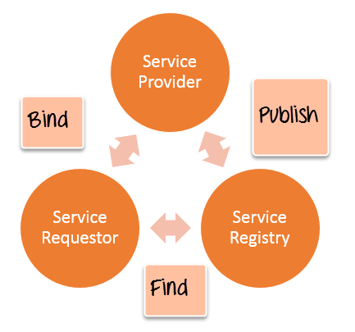
Web Service Roles
Provider
  creates the web service and makes it available
Requestor
  the client application that needs to contact a web service
Service Registry
  a logically centralized directory of services.
  publish new services or find existing ones
Notes:
Provider - The provider creates the web service and makes it available to client application who want to use it.
Requestor - A requestor is nothing but the client application that needs to contact a web service. The client application can be a .Net, Java, or any other language based application which looks for some sort of functionality via a web service.
Broker (Registry) - This is a logically centralized directory of services. The registry provides a central place where developers can publish new services or find existing ones. It therefore serves as a centralized clearing house for companies and their services.
The broker is nothing but the application which provides access to the UDDI. The UDDI, as discussed in the earlier topic enables the client application to locate the web service.

Slide 15
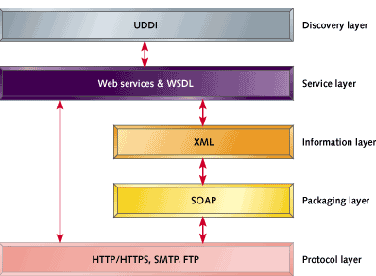
Web Service Protocol Stack
Service Transport
  responsible for transporting messages between applications
  Hyper Text Transport Protocol (HTTP), Simple Mail Transfer Protocol (SMTP)
XML Messaging
  for encoding messages in a common XML
  XML-RPC and SOAP
Service Description
  for describing the public interface to a specific web service
  Web Service Description Language (WSDL)
Service Discovery
  for centralizing services into a common registry and providing easy publish/find functionality
  Universal Description, Discovery, and Integration (UDDI).
Notes:
Service Transport
This layer is responsible for transporting messages between applications. Currently, this layer includes Hyper Text Transport Protocol (HTTP), Simple Mail Transfer Protocol (SMTP), File Transfer Protocol (FTP), and newer protocols such as Blocks Extensible Exchange Protocol (BEEP).
XML Messaging
This layer is responsible for encoding messages in a common XML format so that messages can be understood at either end. Currently, this layer includes XML-RPC and SOAP.
Service Description
This layer is responsible for describing the public interface to a specific web service. Currently, service description is handled via the Web Service Description Language (WSDL).
Service Discovery
This layer is responsible for centralizing services into a common registry and providing easy publish/find functionality. Currently, service discovery is handled via Universal Description, Discovery, and Integration (UDDI).
.

Slide 16
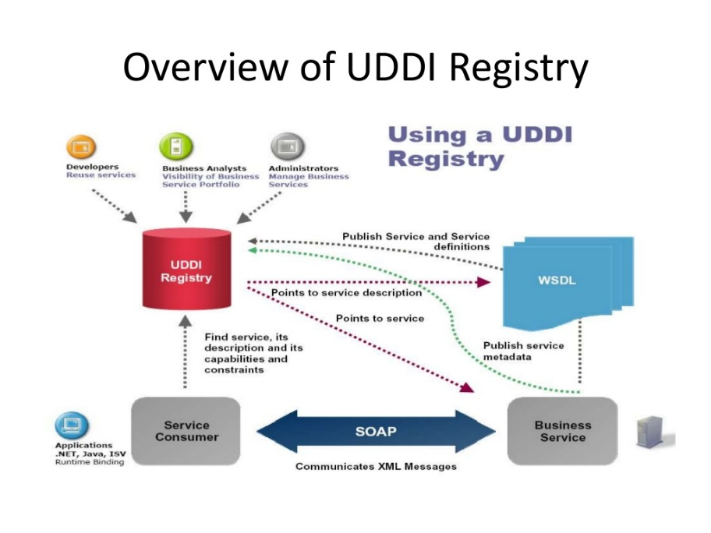
Universal Description, Discovery, and Integration (UDDI)
A specification for a distributed registry of web services
A platform-independent, open framework
Uses Web Service Definition Language (WSDL) to describe interfaces to web services
A registry of all web service metadata
A set of WSDL port type definitions for manipulating and searching that registry
UDDI is entirely optional
Notes:
UDDI offers a way to publish information about web services, as well as provide a mechanism to discover what web services are available. In essence, UDDI is a registration system instantiated as a series of XML files, and associated schema, which contain a description of a business entity and the web services that it offers. It is envisioned that there will ultimately be many public UDDI registration servers distributed about the Web that continually replicate data amongst themselves.
The UDDI specification provides a programmatic interface that allows a business to register a web service and/or search through the registry for a specific web service. Once the desired web service is identified, a pointer to the location of the WSDL document is provided. It is important to note that UDDI is entirely optional. Companies with web services that want to limit specific functionality to people or devices of their choosing need not advertise their service externally.

Slide 17
Overview of SOAP
Definition from SOAP 1.1 Spec
  “SOAP provides a simple and lightweight mechanism for exchanging structured and typed information between peers in a decentralized, distributed environment using XML. ..”
Binding into the network is unspecified
  SOAP does not define how messages are transported between nodes and how they are routed
  Web Services rely on HTTP / JMS etc. for this
Supports various message exchange patterns:
  request/respond
  notification
  Callback

Slide 18
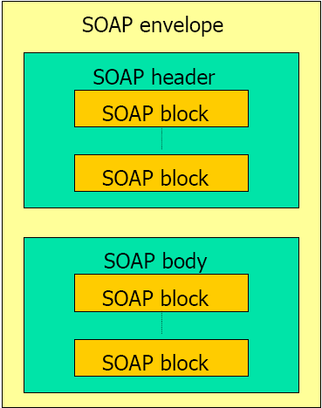
SOAP Message
Envelope
  identifies the XML document as a SOAP message
  encapsulate all the details in the SOAP message
Header
  information such as authentication credentials
  Can contain the definition of complex types (objects) which could be used in the SOAP message
Body
  contains call and response information
Notes:
An Envelope element that identifies the XML document as a SOAP message – This is the containing part of the SOAP message and is used to encapsulate all the details in the SOAP message. This is the root element in the SOAP message.
A Header element that contains header information – The header element can contain information such as authentication credentials which can be used by the calling application. It can also contain the definition of complex types which could be used in the SOAP message. By default, the SOAP message can contain parameters which could be of simple types such as strings and numbers, but can also be a complex object type.
A Body element that contains call and response information – This element is what contains the actual data which needs to be sent between the web service and the calling application.

Slide 19
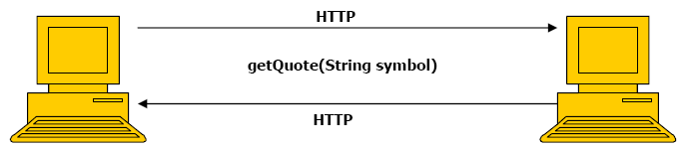
Example SOAP Web Services
<soap:Envelope xmlns: …>
<soap:Body>
<m:getQuote xmlns="urn:xmethods-delayed-quotes“>
<symbol xsi:type="xsd:string">MSFT</symbol>
</m:getQuote>
</soap:Body>
</soap:Envelope>
<soap:Envelope xmlns: …>
<soap:Body>
<n:getQuoteResponse xmlns="urn:xmethods-delayed-quotes">
<Result xsi:type="xsd:float">24.67</Result>
</n:getQuoteResponse>
</soap:Body>
</soap:Envelope>

Slide 20
Web Services Description Language (WSDL)
XML-based file which tells the client application what the web service does
Contains the location of the web service and the methods
all the necessary information that any client application would require to use
Its general structure contains
  Definition
  TargetNamespace
  DataTypes
  Messages
  PortType
  Bindings
  Service
Notes:
WSDL is an XML-based file which tells the client application what the web service does. It is known as the Web Services Description Language(WSDL).
The description is required, so that client applications are able to understand what the web service actually does. The WSDL file contains the location of the web service and The methods which are exposed by the web service.
contains all the necessary information that any client application would require to use the relevant web service

Slide 21
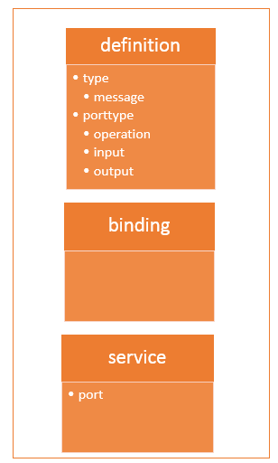
WSDL Structure
Type
  is used to define all the complex datatypes
Message
  explain the input and output operations which can be performed by the web service
portType
  encapsulate every input and output message into one logical operation
binding
  client application calls the relevant port type, then be able to access the operations which are bound to this port type
Service
  name given to the web service itself
Notes:
The <types> tag is used to define all the complex datatypes, which will be used in the message exchanged between the client application and the web service. This is an important aspect of the client application, because if the web service works with a complex data type, then the client application should know how to process the complex data type. Data types such as float, numbers, and strings are all simple data types, but there could be structured data types which may be provided by the web service.
For example, there could be a data type called EmployeeDataType which could have 2 elements called "EmployeeName" of type string and "EmployeeID" of type number or integer. Together they form a data structure which then becomes a complex data type.
The <messages> tag is used to define the message which is exchanged between the client application and the web server. These messages will explain the input and output operations which can be performed by the web service. An example of a message can be a message which accepts the EmployeeID of an employee, and the output message can be the name of the employee based on the EmpoyeeID provided.
The <portType> tag is used to encapsulate every input and output message into one logical operation. So there could be an operation called "GetEmployee" which combines the input message of accepting the EmployeeID from a client application and then sending the EmployeeName as the output message.
The <binding> tag is used to bind the operation to the particular port type. This is so that when the client application calls the relevant port type, it will then be able to access the operations which are bound to this port type. Port types are just like interfaces. So if a client application needs to use a web service they need to use the binding information to ensure that they can connect to the interface provided by that web service.
The <service> tag is a
. Initially, when a client application makes a call to the web service, it will do by calling the name of the web service.

Slide 22
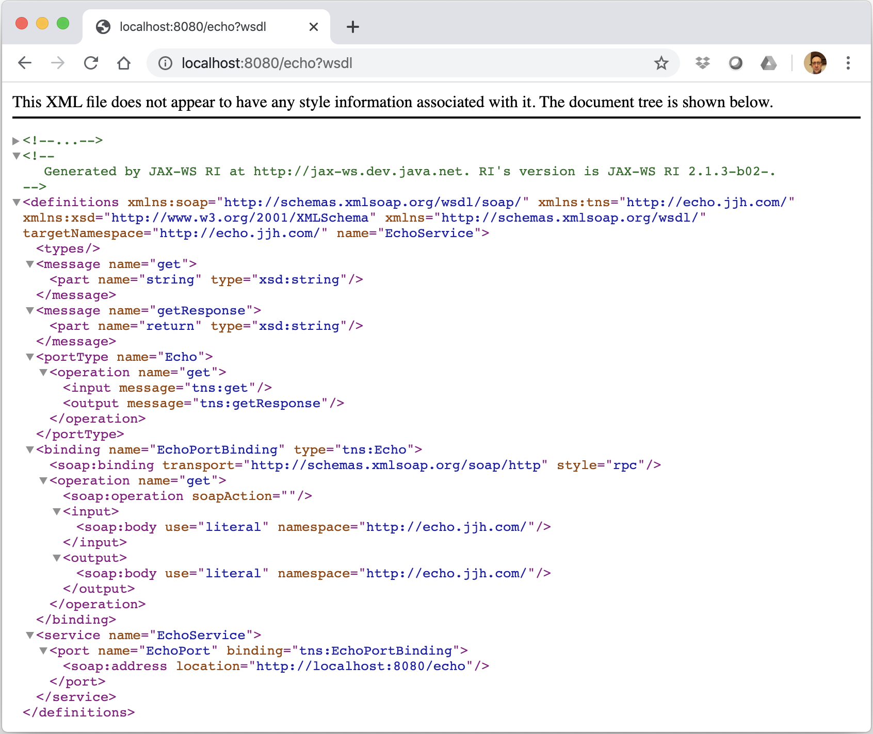
Generated WSDL
JAX-WS server will generate the WSDL for you

Slide 23
Exercise
Definitions
Type −
Message −
  .
Port Type −.
Binding −
Service −
Port −

Slide 24
Exercise
Definitions − HelloService
Type − Using built-in data types and they are defined in XMLSchema.
Message −
  sayHelloRequest − firstName parameter
  sayHelloresponse − greeting return value
Port Type − sayHello operation that consists of a request and a response service.
Binding − Direction to use the SOAP HTTP transport protocol.
Service − Service available at http://www.examples.com/SayHello/
Port − Associates the binding with the URI http://www.examples.com/SayHello/ where the running service can be accessed.

Slide 25
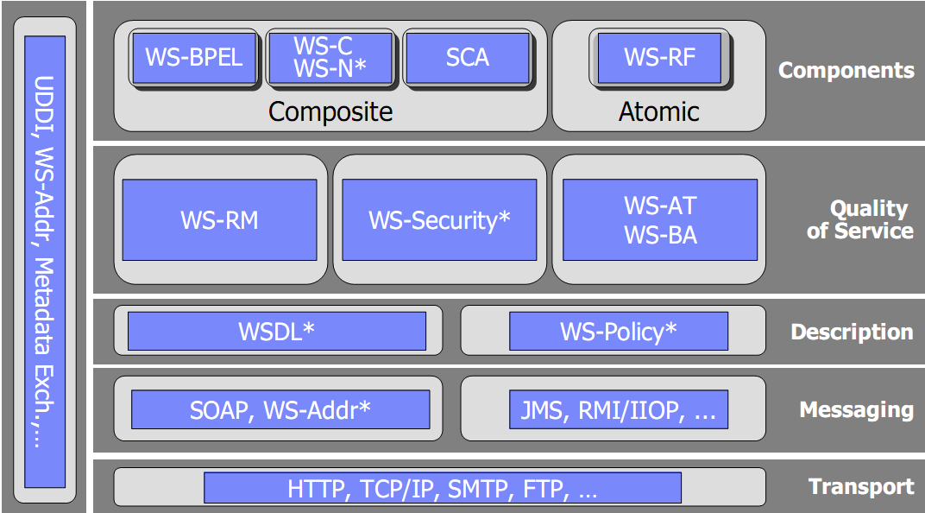
Web Service Standards for SOA
Notes:
WS-AT WS- Web Service Atomic Transaction
WS-BA – Web Service Business Activity
WS-RM - Web Service Reliable Messaging
WS-RF - Web Service Resources framework
WS-C - Web Service Coordination
WS-N – Web Service Notification
SCA – Service Component Architecture

Slide 26

Any questions?
Thank you for your attention
Dr David Wyatt

